Slide 1
Chapter 3: Processes
Process Concept
Process Scheduling
Operations on Processes
Interprocess Communication
Examples of IPC Systems
Communication in Client-Server Systems

Slide 2
Objectives
To introduce the notion of a process -- a program in execution, which forms the basis of all computation
To describe the various features of processes, including scheduling, creation and termination, and communication
To describe communication in client-server systems

Slide 3
Process Concept
An operating system executes a variety of programs:
Batch system – jobs
Time-shared systems – user programs or tasks
Textbook uses the terms job and process almost interchangeably
Process – a program in execution; process execution must progress in sequential fashion
A process includes:
program counter
stack
data section

Slide 4
The Process
Multiple parts
The program code, also called text section
Current activity including program counter, processor registers
Stack containing temporary data
Function parameters, return addresses, local variables
Data section containing global variables
Heap containing memory dynamically allocated during run time
Program is passive entity, process is active
Program becomes process when executable file loaded into memory
Execution of program started via GUI mouse clicks, command line entry of its name, etc
One program can be several processes
Consider multiple users executing the same program
Notes:
A program is a passive entity, such as a file containing a list of instructions stored on disk (often called an executable file). In contrast, a process is an active entity, with a program counter specifying the next instruction to execute and a set of associated resources. A program becomes a process when an executable file is loaded into memory.

Slide 5
Process State
As a process executes, it changes state
new: The process is being created
running: Instructions are being executed
waiting: The process is waiting for some event to occur
ready: The process is waiting to be assigned to a processor
terminated: The process has finished execution

Slide 6
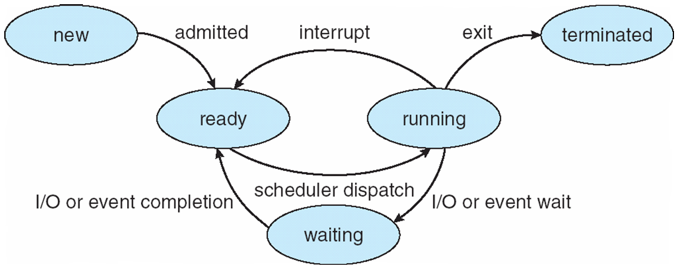
Diagram of Process State

Slide 7
Process Control Block (PCB)
Information associated with each process
Process state
Program counter
CPU registers
CPU scheduling information
Memory-management information
Accounting information
I/O status information

Slide 8
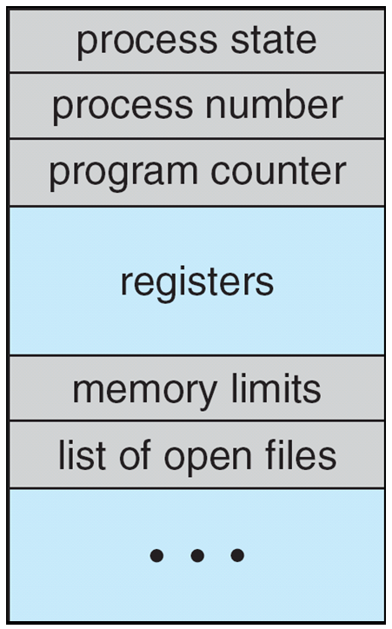
Process Control Block (PCB)

Slide 9
Process state. The state may be new, ready, running, waiting, halted, and so on.
• Program counter. The counter indicates the address of the next instruction to be executed for this process.
• CPU registers. The registers vary in number and type, depending on the computer architecture. They include accumulators, index registers, stack pointers, and general-purpose registers, plus any condition-code information. Along with the program counter, this state information must be saved when an interrupt occurs, to allow the process to be continued correctly afterward.
• CPU-scheduling information. This information includes a process priority, pointers to scheduling queues, and any other scheduling parameters. (Chapter 6 describes process scheduling.)

Slide 10
• Memory-management information. This information may include such items as the value of the base and limit registers and the page tables, or the segment tables, depending on the memory system used by the operating system (Chapter 8).
Accounting information. This information includes the amount of CPU and real time used, time limits, account numbers, job or process numbers,and so on.
• I/O status information. This information includes the list of I/O devices allocated to the process, a list of open files, and so on. In brief, the PCB simply serves as the repository for any information that may vary from process to process.

Slide 11
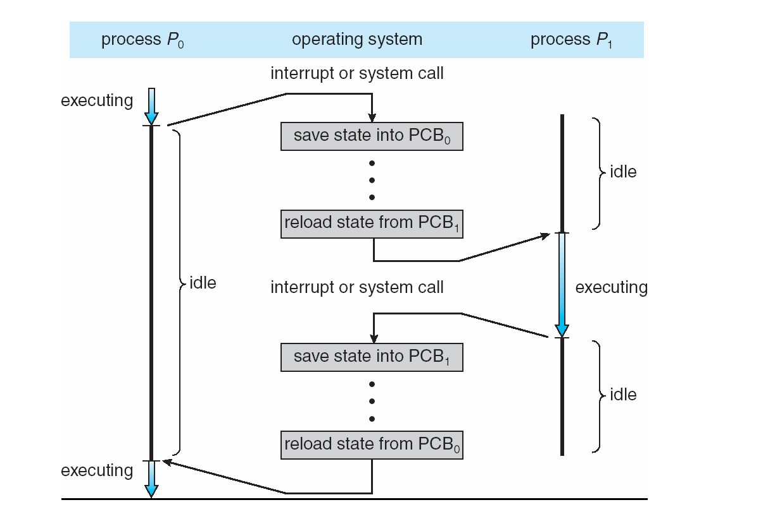
CPU Switch From Process to Process

Slide 12
Process Scheduling
Maximize CPU use, quickly switch processes onto CPU for time sharing
Process scheduler selects among available processes for next execution on CPU
Maintains scheduling queues of processes
Job queue – set of all processes in the system
Ready queue – set of all processes residing in main memory, ready and waiting to execute
Device queues – set of processes waiting for an I/O device
Processes migrate among the various queues

Slide 13
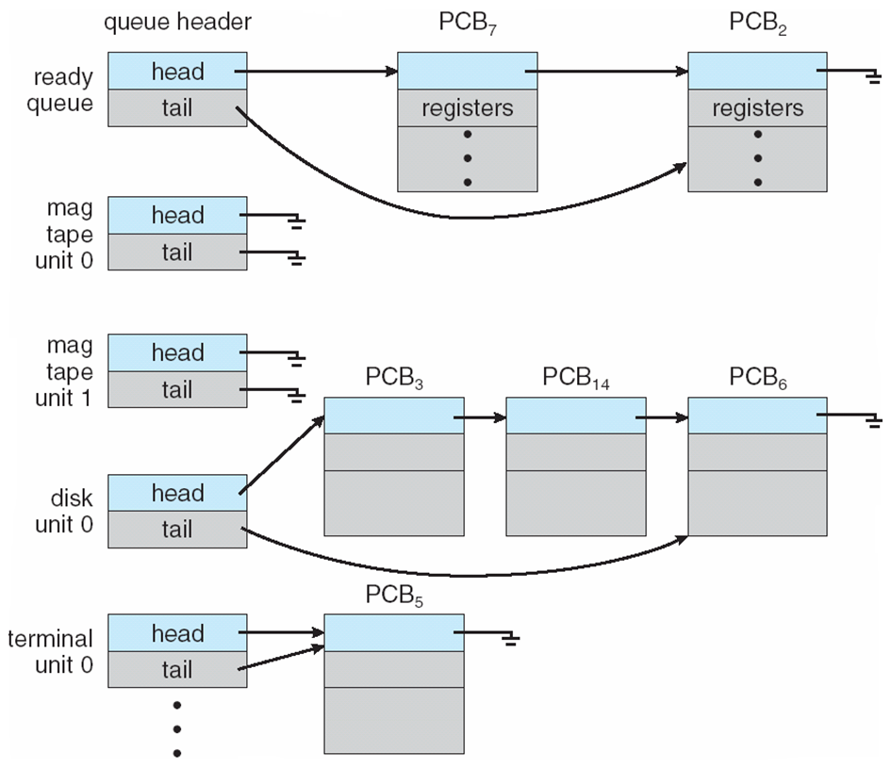
Ready Queue And Various I/O Device Queues

Slide 14
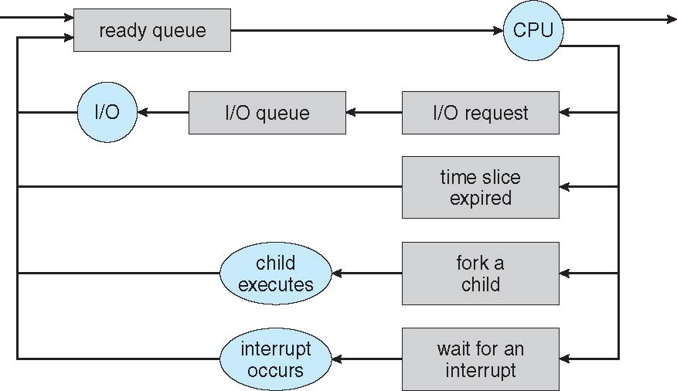
Representation of Process Scheduling

Slide 15
Schedulers
Long-term scheduler (or job scheduler) – selects which processes should be brought into the ready queue
Short-term scheduler (or CPU scheduler) – selects which process should be executed next and allocates CPU
Sometimes the only scheduler in a system
Notes:
Acronym for simultaneous peripheral operations on-line, spooling refers to putting jobs in a buffer, a special area in memory or on a disk where a device can access them when it is ready. Spooling is useful because devices access data at different rates. The buffer provides a waiting station where data can rest while the slower device catches up.

Slide 16
Schedulers (Cont.)
Short-term scheduler is invoked very frequently (milliseconds) ⇒ (must be fast)
Invoked when following events occur
CPU slice of the current process finishes
Current process needs to wait for and event
Clock Interrupt
I/O Interrupt
System Call
Signal
Long-term scheduler is invoked very infrequently (seconds, minutes) ⇒ (may be slow)
The long-term scheduler controls the degree of multiprogramming
Processes can be described as either:
I/O-bound process – spends more time doing I/O than computations, many short CPU bursts
CPU-bound process – spends more time doing computations; few very long CPU bursts
Notes:
CPU Bound means the rate at which process progresses is limited by the speed of the CPU. A task that performs calculations on a small set of numbers, for example multiplying small matrices, is likely to be CPU bound.
I/O Bound means the rate at which a process progresses is limited by the speed of the I/O subsystem. A task that processes data from disk, for example, counting the number of lines in a file is likely to be I/O bound.
Memory bound means the rate at which a process progresses is limited by the amount memory available and the speed of that memory access. A task that processes large amounts of in memory data, for example multiplying large matrices, is likely to be Memory Bound.
Cache bound means the rate at which a process progress is limited by the amount and speed of the cache available. A task that simply processes more data than fits in the cache will be cache bound.
I/O Bound would be slower than Memory Bound would be slower than Cache Bound would be slower than CPU Bound.

Slide 17
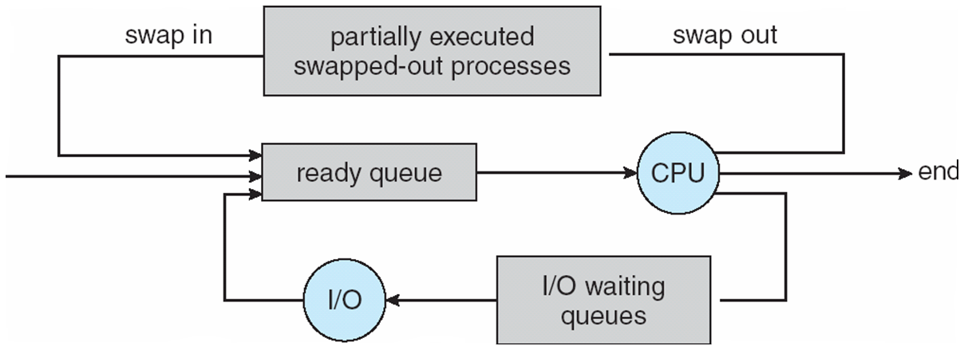
Addition of Medium Term Scheduling

Slide 18
Context Switch
When CPU switches to another process, the system must save the state of the old process and load the saved state for the new process via a context switch.
Context of a process represented in the PCB
Context-switch time is overhead; the system does no useful work while switching
The more complex the OS and the PCB -> longer the context switch
Time dependent on hardware support
Some hardware provides multiple sets of registers per CPU -> multiple contexts loaded at once

Slide 19
Process Creation
Parent process create children processes, which, in turn create other processes, forming a tree of processes
Generally, process identified and managed via a process identifier (pid)
Resource sharing
Parent and children share all resources
Children share subset of parent’s resources
Parent and child share no resources
Execution
Parent and children execute concurrently
Parent waits until children terminate

Slide 20
Process Creation (Cont.)
Address space
Child duplicate of parent
Child has a program loaded into it
UNIX examples
fork system call creates new process
exec system call used after a fork to replace the process’ memory space with a new program

Slide 21
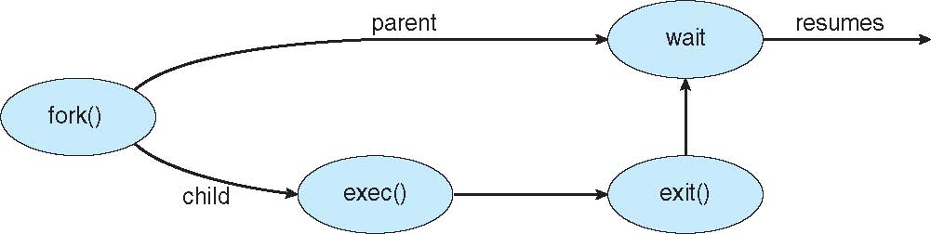
Process Creation

Slide 22
C Program Forking Separate Process
#include <sys/types.h>
#include <studio.h>
#include <unistd.h>
int main()
{
pid_t pid;
/* fork another process */
pid = fork();
if (pid < 0) { /* error occurred */
fprintf(stderr, "Fork Failed");
return 1;
}
else if (pid == 0) { /* child process */
execlp("/bin/ls", "ls", NULL);
}
else { /* parent process */
/* parent will wait for the child */
wait (NULL);
printf ("Child Complete");
}
return 0;
}

Slide 23
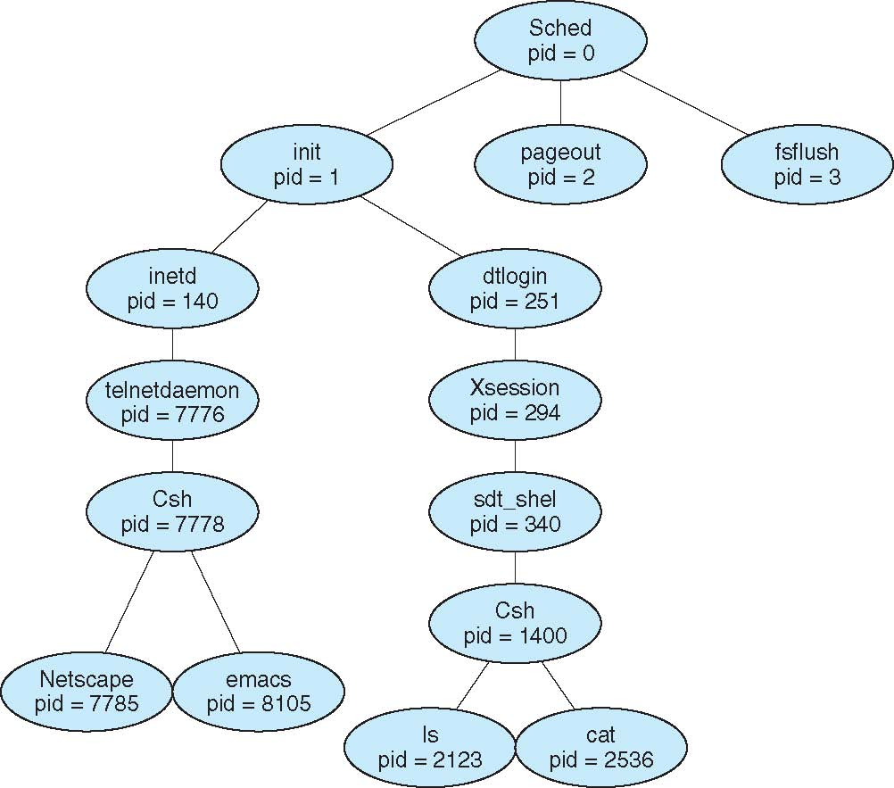
A Tree of Processes on Solaris

Slide 24
Process Termination
Process executes last statement and asks the operating system to delete it (exit)
Output data from child to parent (via wait)
Process’ resources are deallocated by operating system
Parent may terminate execution of children processes (abort)
Child has exceeded allocated resources
Task assigned to child is no longer required
If parent is exiting
Some operating systems do not allow child to continue if its parent terminates
All children terminated - cascading termination

Slide 25
Interprocess Communication
Processes within a system may be independent or cooperating
Cooperating process can affect or be affected by other processes, including sharing data
Reasons for cooperating processes:
Information sharing
Computation speedup
Modularity
Convenience
Cooperating processes need interprocess communication (IPC)
Two models of IPC
Shared memory
Message passing

Slide 26
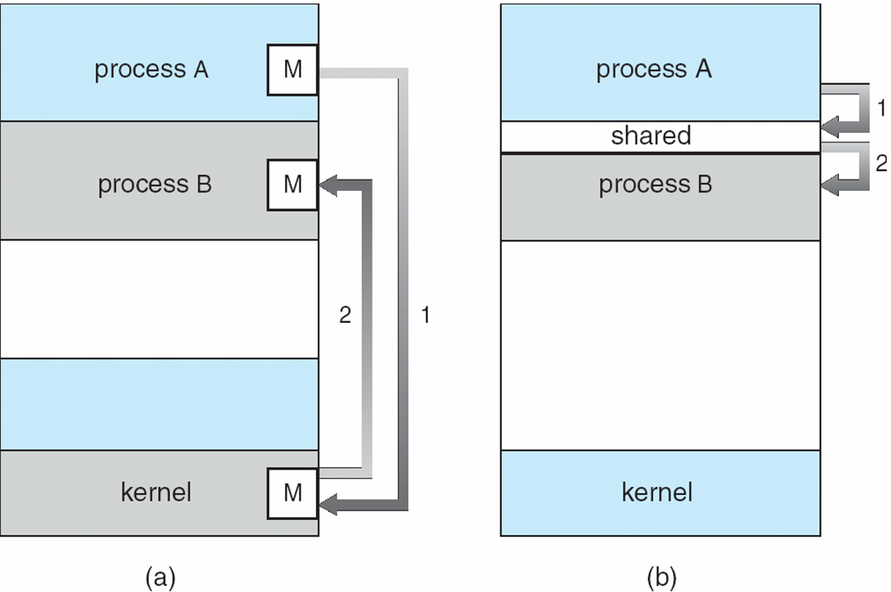
Communications Models

Slide 27
Cooperating Processes
Independent process cannot affect or be affected by the execution of another process
Cooperating process can affect or be affected by the execution of another process
Advantages of process cooperation
Information sharing
Computation speed-up
Modularity
Convenience

Slide 28
Producer-Consumer Problem
Paradigm for cooperating processes, producer process produces information that is consumed by a consumer process
unbounded-buffer places no practical limit on the size of the buffer
bounded-buffer assumes that there is a fixed buffer size

Slide 29
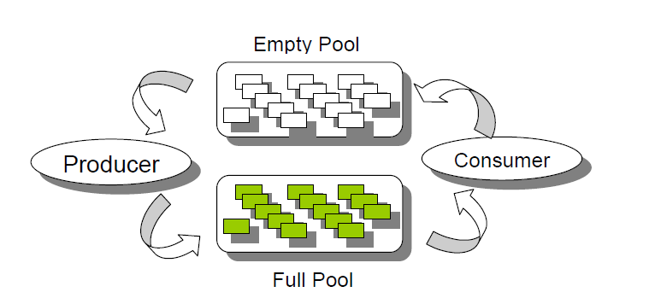

Slide 30
Bounded-Buffer – Shared-Memory Solution
Shared data
#define BUFFER_SIZE 10
typedef struct {
. . .
} item;
item buffer[BUFFER_SIZE];
int in = 0; “indicates that where next item would go”
int out = 0;” which item will consume”
Solution is correct, but can only use BUFFER_SIZE-1 elements

Slide 31
Bounded-Buffer – Producer
while (true) { /* Produce an item */
while (((in = (in + 1) % BUFFER SIZE ) == out)
; /* do nothing -- no free buffers */
buffer[in] = item;
in = (in + 1) % BUFFER SIZE;
}

Slide 32
Bounded Buffer – Consumer
while (true) {
while (in == out)
; // do nothing -- nothing to consume
// remove an item from the buffer
item = buffer[out];
out = (out + 1) % BUFFER SIZE;
return item;
}

Slide 33
Interprocess Communication – Message Passing
Mechanism for processes to communicate and to synchronize their actions
Message system – processes communicate with each other without resorting to shared variables
IPC facility provides two operations:
send(message) – message size fixed or variable
receive(message)
If P and Q wish to communicate, they need to:
establish a communication link between them
exchange messages via send/receive
Implementation of communication link
physical (e.g., shared memory, hardware bus)
logical (e.g., logical properties)

Slide 34
Implementation Questions
How are links established?
Can a link be associated with more than two processes?
How many links can there be between every pair of communicating processes?
What is the capacity of a link?
Is the size of a message that the link can accommodate fixed or variable?
Is a link unidirectional or bi-directional?

Slide 35
Direct Communication
Processes must name each other explicitly:
send (P, message) – send a message to process P
receive(Q, message) – receive a message from process Q
Properties of communication link
Links are established automatically
A link is associated with exactly one pair of communicating processes
Between each pair there exists exactly one link
The link may be unidirectional, but is usually bi-directional
Symmetry
, Asymmetry ( send (p, message) receive( id , message)

Slide 36

Indirect Communication
Messages are directed and received from mailboxes (also referred to as ports)
Each mailbox has a unique id
Processes can communicate only if they share a mailbox
Properties of communication link
Link established only if processes share a common mailbox
A link may be associated with many processes
Each pair of processes may share several communication links
Link may be unidirectional or bi-directional

Slide 37
Indirect Communication
Operations
create a new mailbox
send and receive messages through mailbox
destroy a mailbox
Primitives are defined as:
send(A, message) – send a message to mailbox A
receive(A, message) – receive a message from mailbox A

Slide 38
Indirect Communication
Mailbox sharing
P₁, P₂, and P₃ share mailbox A
P₁, sends; P₂ and P₃ receive
Who gets the message?
Solutions
Allow a link to be associated with at most two processes
Allow only one process at a time to execute a receive operation
Allow the system to select arbitrarily the receiver. Sender is notified who the receiver was.

Slide 39
Synchronization
Message passing may be either blocking or non-blocking
Blocking is considered synchronous
Blocking send has the sender block until the message is received
Blocking receive has the receiver block until a message is available
Non-blocking is considered asynchronous
Non-blocking send has the sender send the message and continue
Non-blocking receive has the receiver receive a valid message or null

Slide 40
Buffering
Queue of messages attached to the link; implemented in one of three ways
1. Zero capacity – 0 messages Sender must wait for receiver
2. Bounded capacity – finite length of n messages Sender must wait if link full
3. Unbounded capacity – infinite length Sender never waits

Slide 41
Examples of IPC Systems - POSIX
POSIX Shared Memory
Process first creates shared memory segment
segment id = shmget(IPC PRIVATE, size, S IRUSR | S IWUSR);
Process wanting access to that shared memory must attach to it
shared memory = (char *) shmat(id, NULL, 0);
Now the process could write to the shared memory
sprintf(shared memory, "Writing to shared memory");
When done a process can detach the shared memory from its address space
shmdt(shared memory);

Slide 42
Examples of IPC Systems - Mach
Mach communication is message based
Even system calls are messages
Each task gets two mailboxes at creation- Kernel and Notify
Only three system calls needed for message transfer
msg_send(), msg_receive(), msg_rpc()
Mailboxes needed for commuication, created via
port_allocate()

Slide 43
Examples of IPC Systems – Windows XP
Message-passing centric via local procedure call (LPC) facility
Only works between processes on the same system
Uses ports (like mailboxes) to establish and maintain communication channels
Communication works as follows:
The client opens a handle to the subsystem’s connection port object.
The client sends a connection request.
The server creates two private communication ports and returns the handle to one of them to the client.
The client and server use the corresponding port handle to send messages or callbacks and to listen for replies.

Slide 44
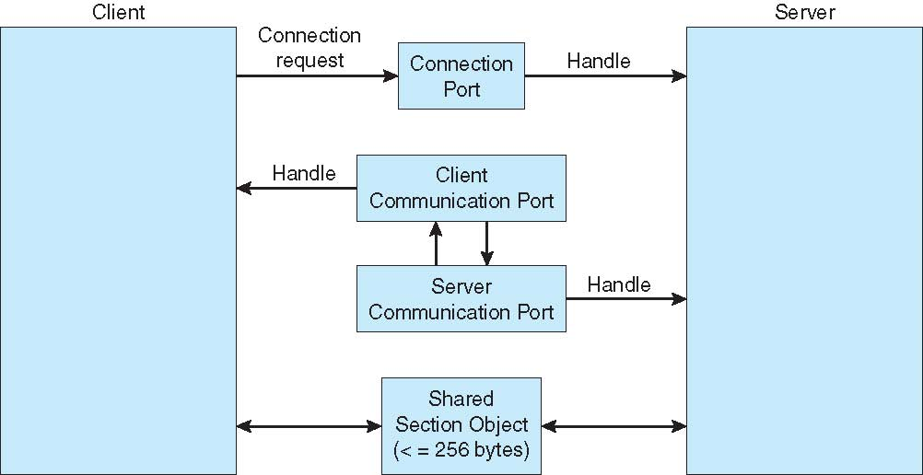
Local Procedure Calls in Windows XP

Slide 45
Communications in Client-Server Systems
Sockets
Remote Procedure Calls
Pipes
Remote Method Invocation (Java)

Slide 46
Sockets
A socket is defined as an endpoint for communication
Concatenation of IP address and port
The socket 161.25.19.8:1625 refers to port 1625 on host 161.25.19.8
Communication consists between a pair of sockets

Slide 47
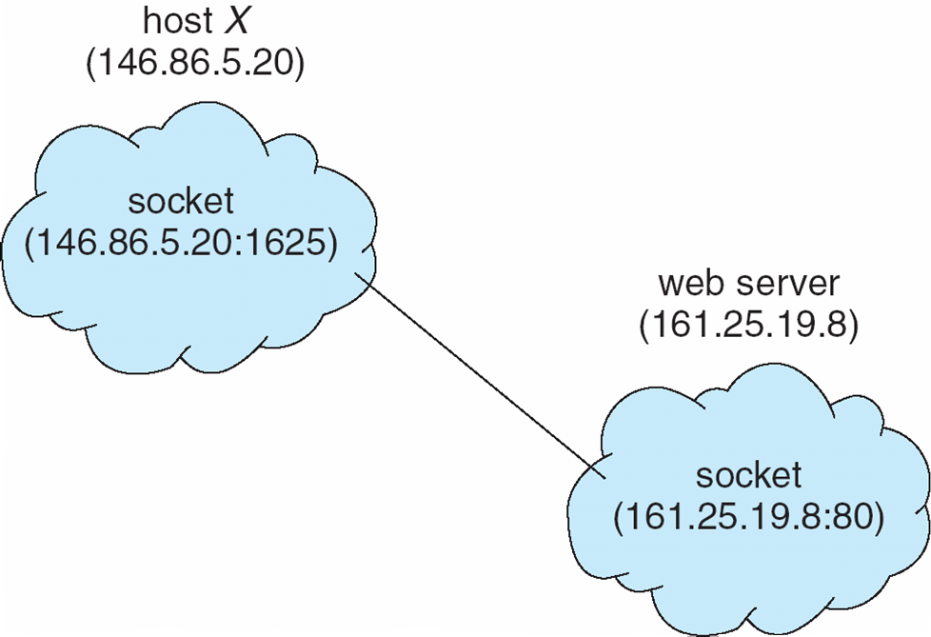
Socket Communication

Slide 48
Remote Procedure Calls
Remote procedure call (RPC) abstracts procedure calls between processes on networked systems
Stubs – client-side proxy for the actual procedure on the server
The client-side stub locates the server and marshalls the parameters
The server-side stub receives this message, unpacks the marshalled parameters, and performs the procedure on the server

Slide 49
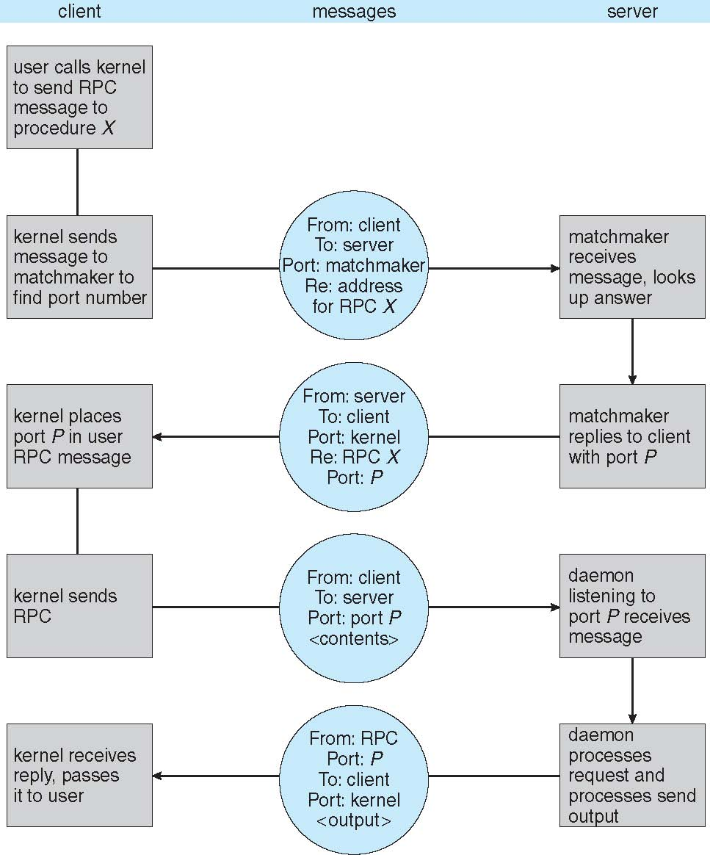
Execution of RPC

Slide 50
Pipes
Acts as a conduit allowing two processes to communicate
Issues
Is communication unidirectional or bidirectional?
In the case of two-way communication, is it half or full-duplex?
Must there exist a relationship (i.e. parent-child) between the communicating processes?
Can the pipes be used over a network?

Slide 51
Ordinary Pipes
Ordinary Pipes allow communication in standard producer-consumer style
Producer writes to one end (the write-end of the pipe)
Consumer reads from the other end (the read-end of the pipe)
Ordinary pipes are therefore unidirectional
Require parent-child relationship between communicating processes

Slide 52
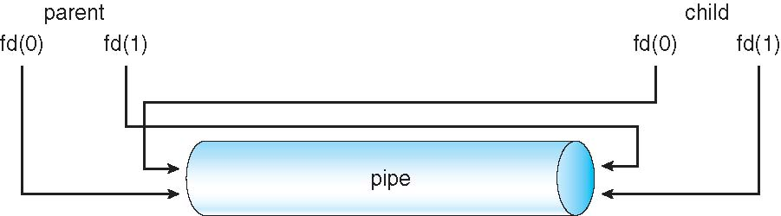
Ordinary Pipes

Slide 53
Named Pipes
Named Pipes are more powerful than ordinary pipes
Communication is bidirectional
No parent-child relationship is necessary between the communicating processes
Several processes can use the named pipe for communication
Provided on both UNIX and Windows systems

